Slide 1
Game Analysis Using SQL
Vanmathi K
Intern at Mentorness

Slide 2

Introduction
NOTE:
To change images on this slide, select a picture and delete it. Then click the Insert Picture icon
in the placeholder to insert your own image.
Game analysis with SQL involves leveraging structured query language to dissect player behaviors, track in-game metrics, and uncover insights from vast datasets. By querying game databases, developers and analysts can identify trends, optimize gameplay, and enhance player experiences through data-driven decision-making

Slide 3
Project Overview
Our projects centers around the Exploration of a gaming dataset, which Encapsulate a wealth of information about Player activities, Game metrics and Device used.
Leveraging the power of SQL, we aim to unravel insights the lied on individual player achievement and game trends and the impact of different devices on user engagement.

Slide 4
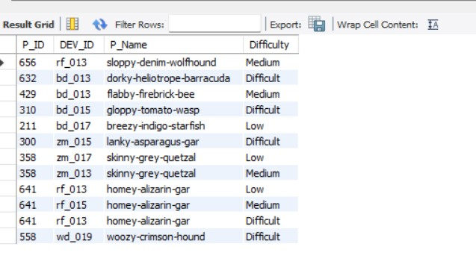
Q1) Extract P_ID, Dev_ID, PName and Difficulty_level of all players at level 0
Query
SELECT P_ID, DEV_ID, P_Name, Difficulty FROM game.det
WHERE level="0";

Slide 5
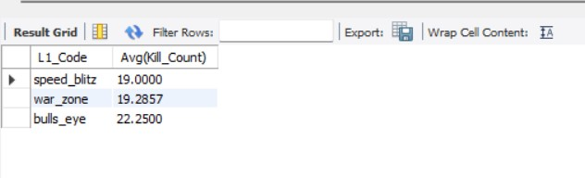
Q2) Find Level1_code wise Avg_Kill_Count where lives_earned is 2 and atleast 3 stages are crossed
Query
SELECT L1_Code, Avg(Kill_Count) FROM game.det
WHERE Lives_Earned = "2" AND Stages_crossed > 3
GROUP BY L1_Code

Slide 6
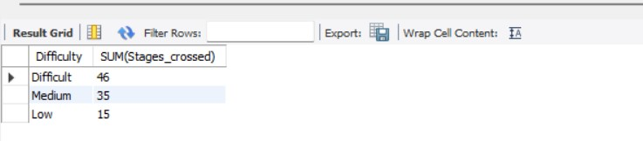
Q3) Find the total number of stages crossed at each difficulty level where for Level2 with players use zm_series devices. Arrange the result in decreasing order of total number of stages crossed.
Query
SELECT Difficulty, SUM(Stages_crossed) FROM game.det
WHERE level="2" AND Dev_ID LIKE "zm%“
GROUP BY Difficulty
ORDER BY SUM(Stages_crossed) DESC

Slide 7
Q4) Extract P_ID and the total number of unique dates for those players who have played games on multiple days.
Query
SELECT P_ID, COUNT(DISTINCT DATE(TimeStamp)) FROM game.det
GROUP BY P_ID
HAVING COUNT(DISTINCT DATE(TimeStamp)) >1

Slide 8
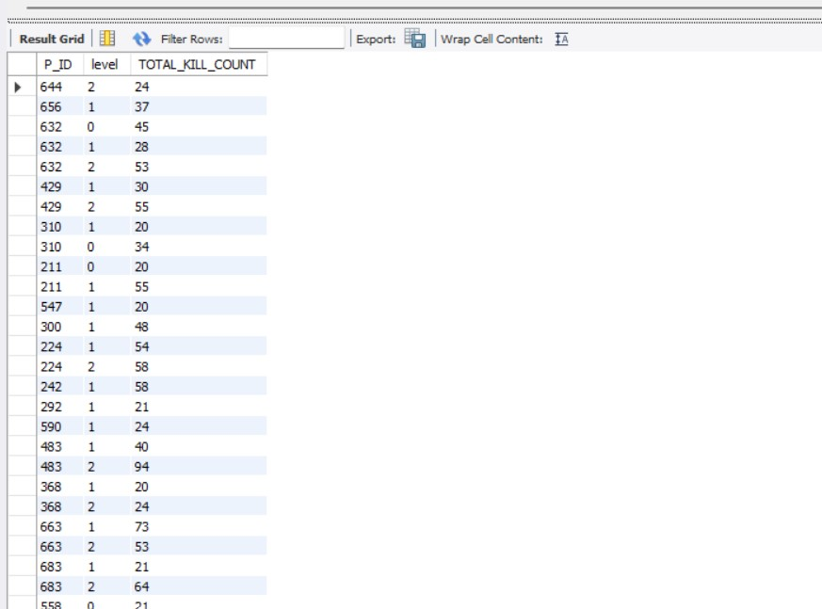
Q5) Find P_ID and level wise sum of kill_counts where kill_count is greater than avg kill count for the Medium difficulty.
Query
SELECT P_ID,level, SUM(Kill_Count) AS TOTAL_KILL_COUNT FROM game.det
WHERE Kill_Count > (SELECT AVG(Kill_Count) FROM game.det
WHERE Difficulty = "Medium")
GROUP BY P_ID,level

Slide 9
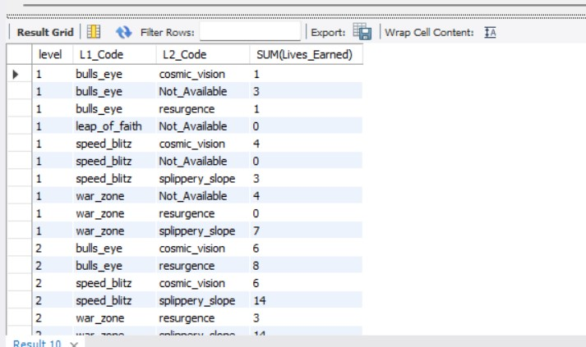
Q6)Find Level and its corresponding Level code wise sum of lives earned excluding level 0. Arrange in asecending order of level.
SELECT level,L1_Code,L2_Code, SUM(Lives_Earned) FROM game.det
WHERE level != "0“
GROUP BY level,L1_Code,L2_Code
ORDER BY level ASC

Slide 10
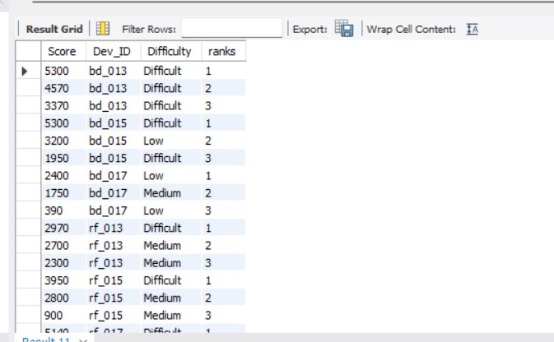
Q7) Find Top 3 score based on each dev_id and Rank them in increasing order using Row_Number. Display difficulty as well.
WITH Rankedscores AS (
SELECT P_ID, Dev_ID, Score, Difficulty, row number() OVER (PARTITION BY Dev_ID ORDER BY Score desc ) AS 'Rank' FROM game.det
SELECT Dev_ID, Score, Difficulty FROM Rankedscores
WHERE 'Rank' <= 3

Slide 11
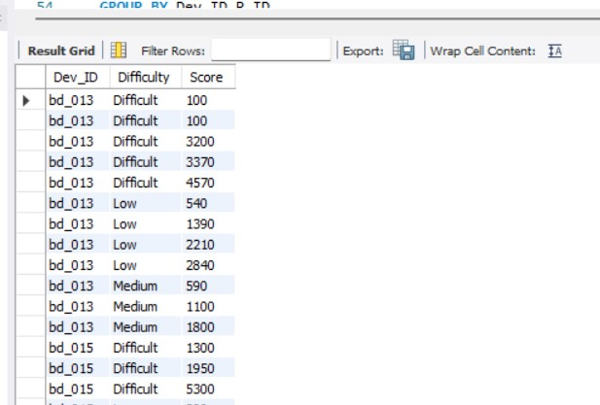
Q9)Find Top 5 score based on each difficulty level and Rank them in increasing order using Rank. Display dev_id as well.
SELECT Dev_ID, Difficulty,SUM(Score) FROM game.det
GROUP BY Difficulty ,Dev_ID
ORDER BY Row_No ASC

Slide 12
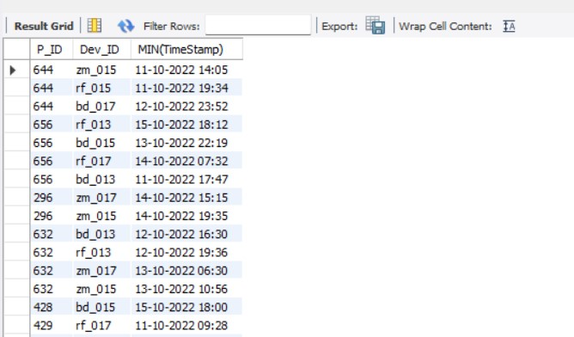
Q10) Find the device ID that is first logged in(based on start_datetime) for each player(p_id). Output should contain player id, device id and first login datetime.
SELECT DISTINCT(P_ID),Dev_ID, MIN(Data_Time) FROM game.det
GROUP BY Dev_ID,P_ID

Slide 13
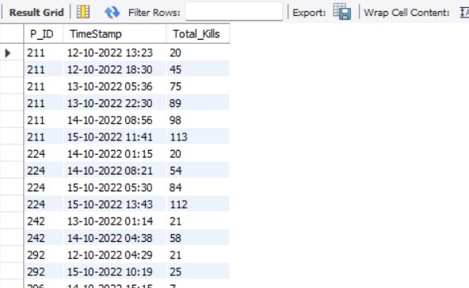
Q11) For each player and date, how many kill_count played so far by the player. That is, the total number of games played by the player until that date.
SELECT P_ID, Data_Time,SUM(Kill_Count)OVER ( PARTITION BY P_ID ORDER BY Data_Time) AS Total_Kills FROM game.det

Slide 14
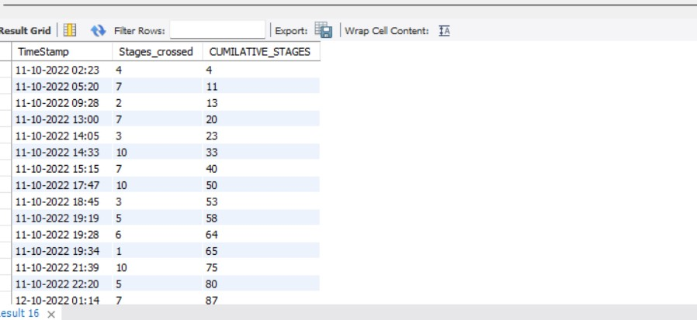
Q12) Find the cumulative sum of stages crossed over a start_datetime
SELECT Data_Time,Stages_crossed, SUM(Stages_crossed) OVER(ORDER BY Data_Time) AS CUMILATIVE_STAGES FROM game.det

Slide 15
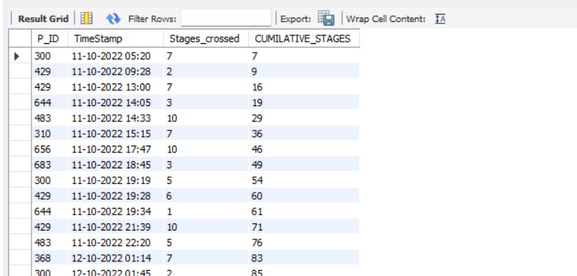
Q13) Find the cumulative sum of an stages crossed over a start_datetime for each player id but exclude the most recent start_datetime
SELECT P_ID,Data_Time,Stages_crossed, SUM(Stages_crossed) OVER(ORDER BY Data_Time) AS CUMILATIVE_STAGES FROM game.det
WHERE Data_Time != (SELECT MIN(Data_TIme) FROM game.det)

Slide 16
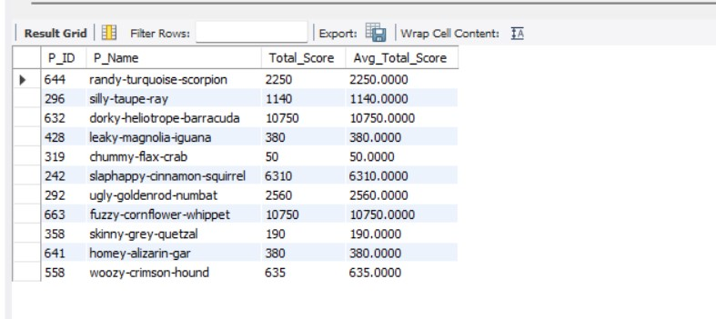
Q14) Extract top 3 highest sum of score for each device id and the corresponding player_id
WITH Rankscores AS (SELECT P_ID, Dev_ID, SUM(Score) AS TOTAL_SCORE , ROW_NUMBER() OVER (PARTITION BY Dev_ID
ORDER BY SUM(Score) DESC) AS Rank ROM game.det
GROUP BY P_ID, Dev_ID)SELECT P_ID, Dev_ID, TOTAL_SCORE FROM RankscoreWHERE Rank <=3

Slide 17
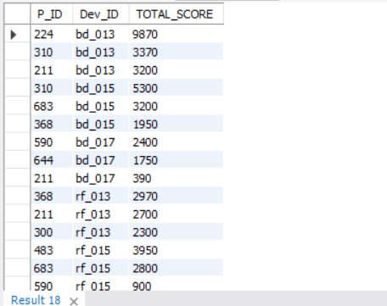
Q15) Find players who scored more than 50% of the avg score scored by sum of scores for each player_id
WITH playeravgscore AS (
SELECT P_ID, AVG(Score) AS AVG_SCORE FROM game.det
GROUP BY P_ID)
SELECT P_ID,Score FROM game.det gd JOIN playeravgscore pas ON gs.P_ID = pas.P_ID
WHERE gd.Score > 0.5*pas.AVG_SCORE

Slide 18
Q16) Create a stored procedure to find top n headshots_count based on each dev_id and Rank them in increasing order sing Row_Number. Display difficulty as well.
Query
DELIMITER //
CREATE PROCEDURE GetTopNHeadshots (IN n INT)
BEGIN
SELECT Dev_ID, Difficulty, headshots_count, ROW_NUMBER() OVER (PARTITION BY Dev_ID
ORDER BY headshots_count DESC) AS 'Rank' FROM game.det
WHERE 'Rank' <=n;
END//DELIMITER;CALL GetTopNHeadshots(3);

Slide 19
Q17) Create a function to return sum of Score for a given player_id.
Query
CREATE FUNCTION get_total_score(P_ID INT) RETURN INT
BEGIN
DECLARE total_score INT;
SELECT SUM(Score) INTO total_score FROM det
WHERE P_ID = P_ID;
RETURN total_score;
END;
SELECT get_total_score(123);

Slide 20
Thank you

